Slide 1

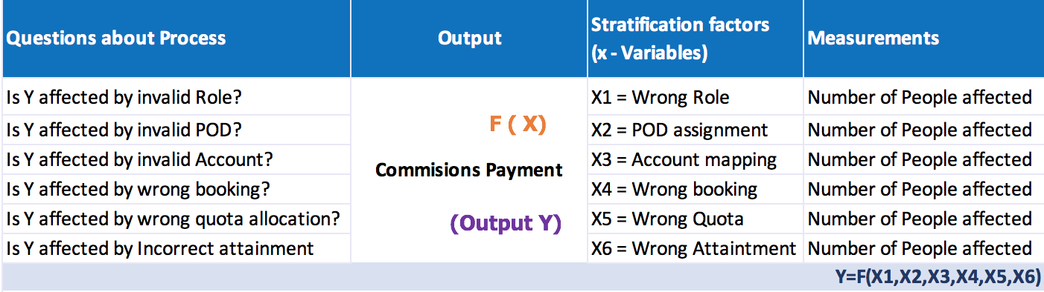
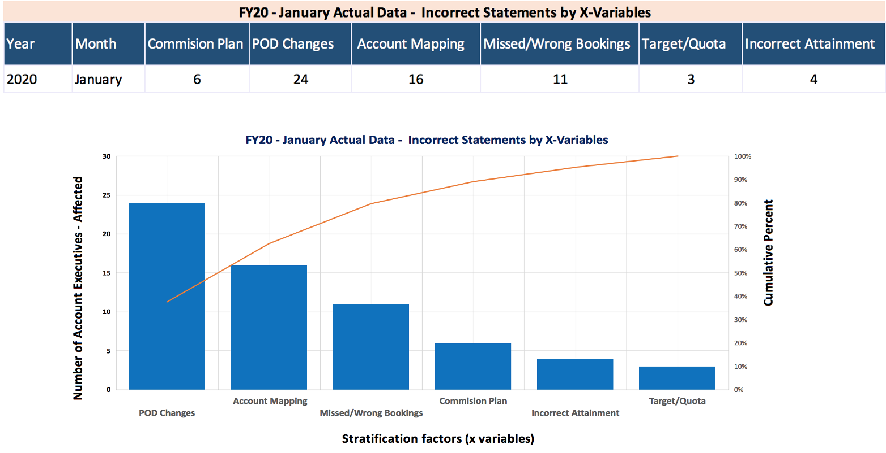
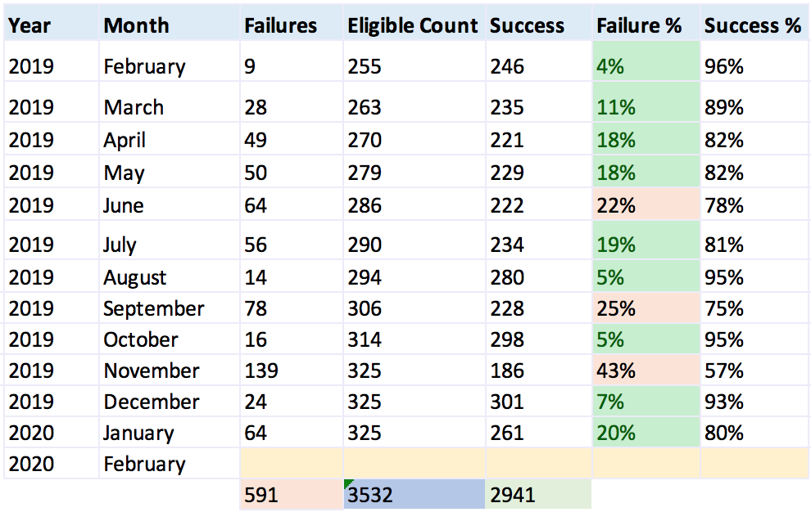
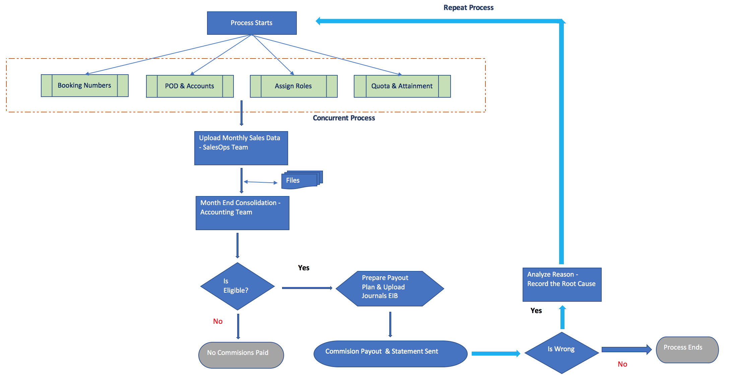
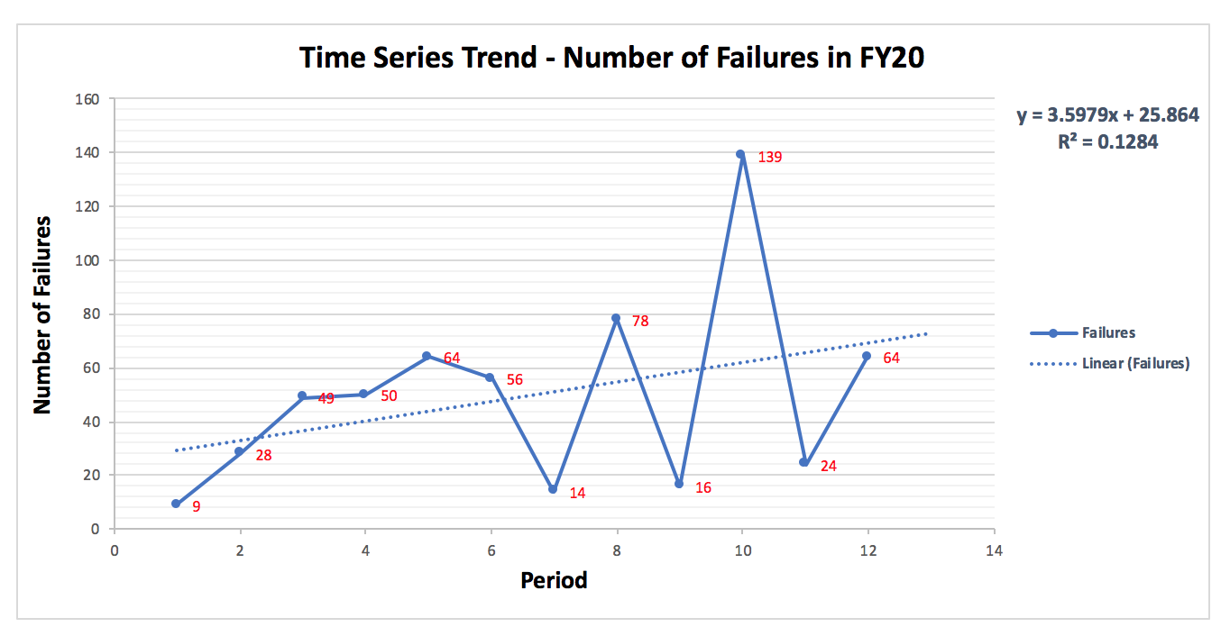
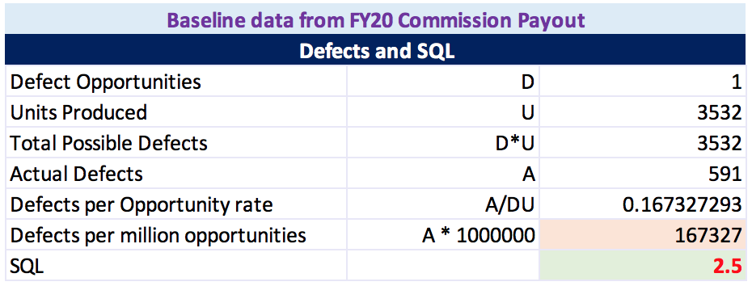
Process Improvement Project – Improve Sales Commission Process
Problem Statement
It has been reported repeatedly that employees enrolled for commissions pay often paid incorrectly. Their unique compensation is managed very differently and in disparate systems, mostly manual.
X-variables
Problem
Missed and Incorrect manual tagging were identified as primary factors causing mistakes in commissions calculation
D
Define
M
Measure
A
Analyze
I
Improve
C
Control
Business Impact
Proposed Solution
Incorporate system driven values, pre/post-validations and enhanced fields for calculations
Jan-14
Impacts reported as in 10s of thousands of dollars not paid to Sales Executives on time.
Jan-21
Jan -28
Feb-12
Feb-26
Next Steps
Mar-10
Controls to get timely bookings import
Add more transparency on what AEs expect to get paid vs. actually paid on, so that AEs can raise concerns before commission payments are uploaded to ADP
Continuously monitor for next several months to isolate noise from signals
SQL 2.5?
Trending in one direction
591 vs 3532 Statements issued
Prepared by: Sathish Kumar Rajendiran

Slide 2

Foundational Elements Involved
DEFINE
MEASURE
Y = F(X)
ANALYZE
DMAIC
CONTROL
IMPROVE
Prepared by: Sathish Kumar Rajendiran

Slide 3
DEFINE
Executive Summary
Accounting was seeking a solution to streamline the team’s month end commission payout process. The existing commission process required manual manipulation of accounting data in Excel spreadsheets that increased the risk of error. It was time consuming, frustrating, and detracted from more valuable aspects of accounting’s month end activities.
Problem Statement
It has been reported repeatedly that employees enrolled for commissions pay often paid incorrectly. Their unique compensation is managed very differently and in disparate systems, mostly manual.
Business Impact
Current process has complex calculation and often involves ad hoc adjustments. Impacts have been reported as in 10s of thousands of dollars not paid to Sales Executives on time.
Goal
Re-vamping the Commissions process to ensure 100% accuracy on Commission payments and having all the calculation logic built in centralized place. Provide, solutioning & recommendation to SalesOps & Accounting team to help achieve the results.
Prepared by: Sathish Kumar Rajendiran

Slide 4
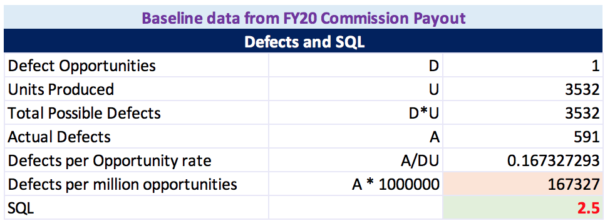
DEFINE
Project Scope
In scope: Work with Sales Ops to Understand, Document, Identify, Propose Solution. Handover the process/Solutioning to Sales Ops. This is for US region only.
Out of Scope: Defining the Commission Type, Mapping Employee to Sales Roles, Generating EIB file for accounting (Journal entries), Communication to AEs. Non-US regions are out of scope of this project
Team
Accounting Team Owns the process; However, the request has come from SalesOps whose Account Executives and their Managers are heavily impacted on their monthly/Quarterly commissions.
I am working with stakeholders on Data Collection, Analysis and Identifying the factors to improve the overall process.
SQL 2.5
Baseline Data Analysis for Sigma Quality Level
SQL –A sigma quality level serves as an indicator of how often defects are likely to occur in processes, parts, or products. It can be used to describe if the process is capable of meeting customer requirements.
DPMO (defects per million opportunities) is a calculation that, when answered, defines a ratio of the number of defects in a sample to the total number of defect opportunities multiplied by one million.
DPMO 167327
Prepared by: Sathish Kumar Rajendiran

Slide 5
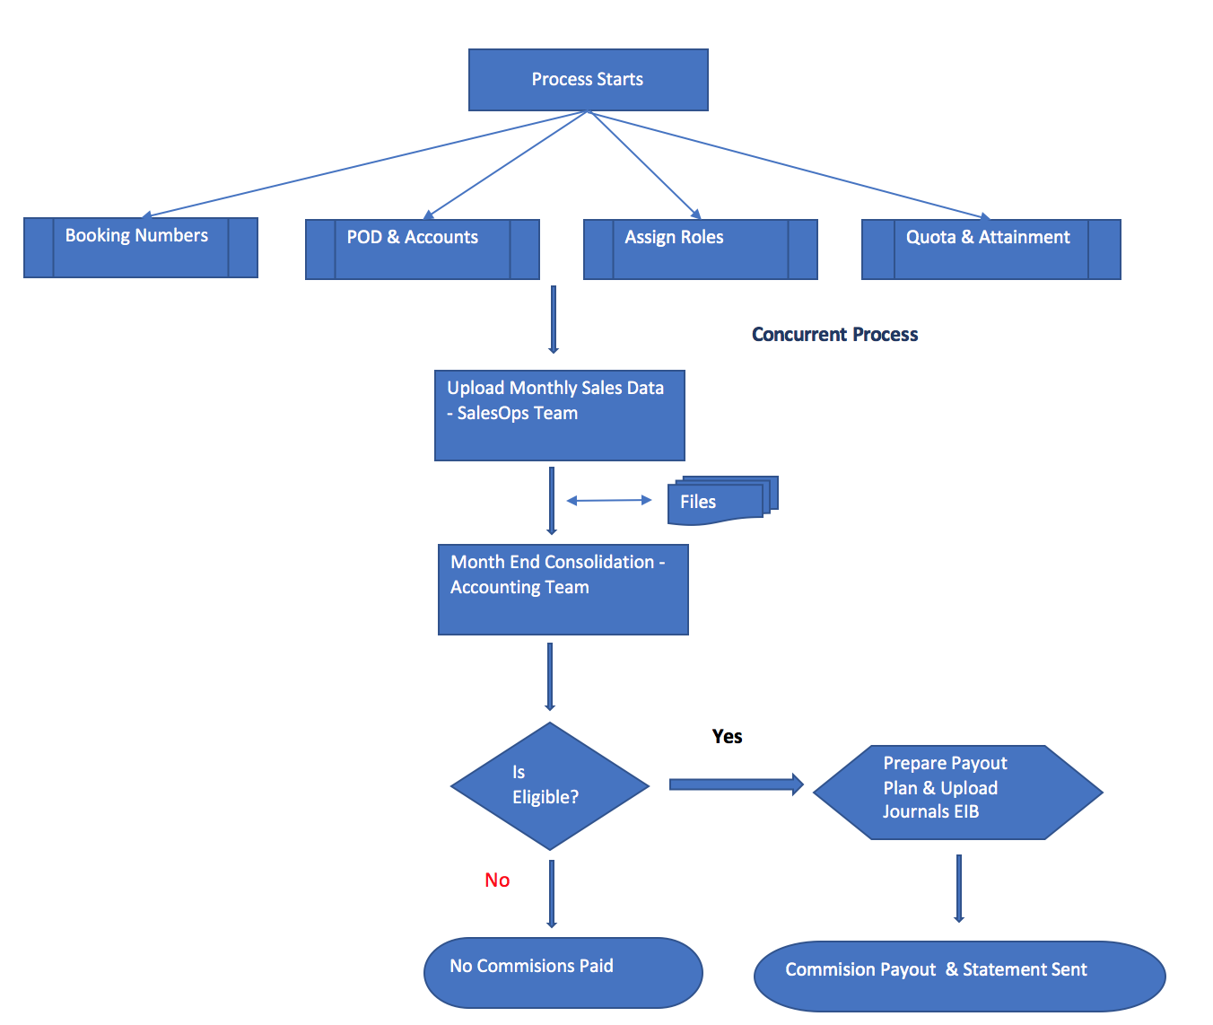
Business Process - Flowchart of the Commissions Process
Current State
Prepared by: Sathish Kumar Rajendiran

Slide 6
Measure Tool Used: Data Stratification Tree
Data Stratification Tree
I thought Data Stratification Tree would be appropriate here as Identifying and eliminating the x-variable would improve the quality of the Commissions process. So, I went through top few variable would really make an impact. After meeting with SalesOps and Accounting team , I have inferred that it’s a combination both human error (wrong booking details entered in the system, quota allocation.) and process changes in other systems (Account/territory movement etc.).
However, We didn’t have solid evidences captured in the system that what was done to adjust the commissions whenever a conflict was recorded. So, I couldn’t go back and reconcile the numbers against these variable. We have recommended including the Reason category as mandatory going forward. Fortunately, I was able to get the numbers reconciled for most of Jan 2020 as it was very recent.
Prepared by: Sathish Kumar Rajendiran

Slide 7
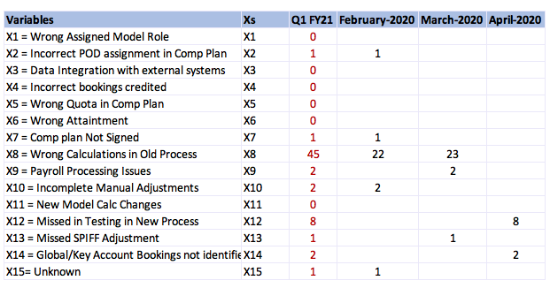
Measure – Variables spread in Q1 FY21
Prepared by: Sathish Kumar Rajendiran

Slide 8
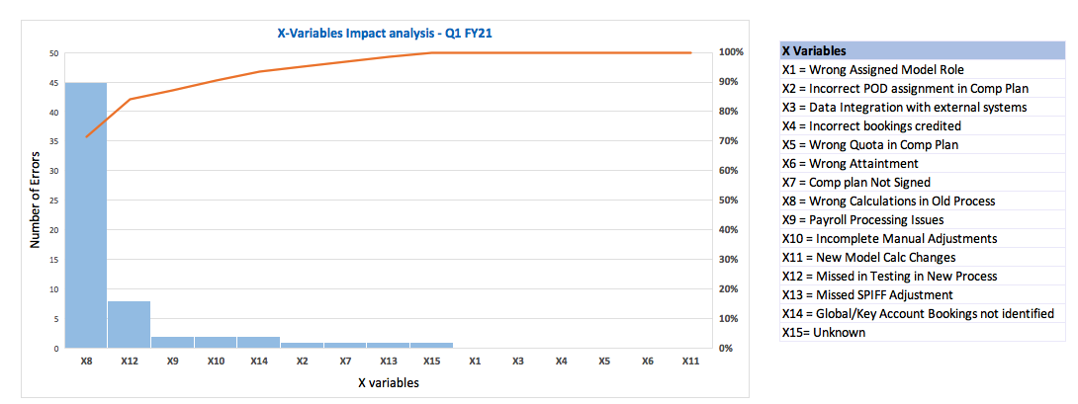
Measure – Impact on Stratification factors Q1 FY21
Prepared by: Sathish Kumar Rajendiran

Slide 9
Analyze
Prepared by: Sathish Kumar Rajendiran

Slide 10
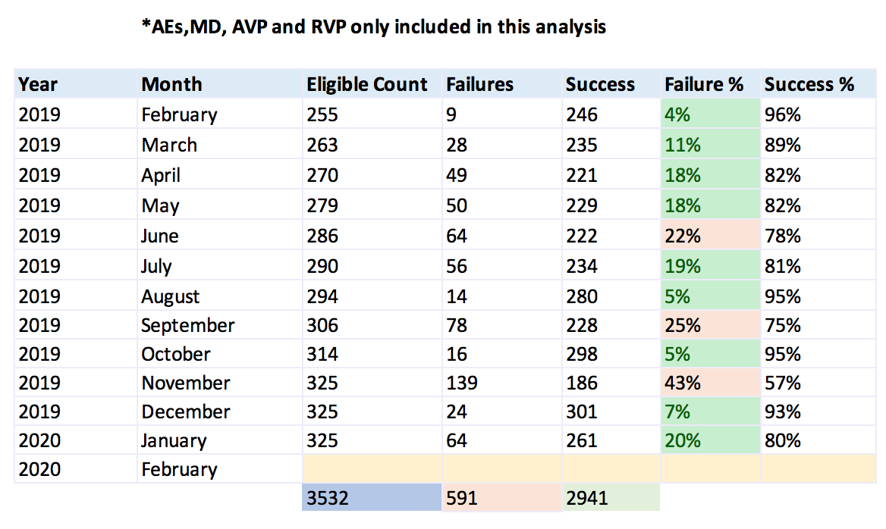
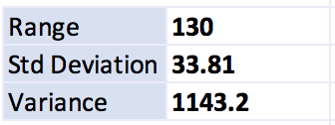
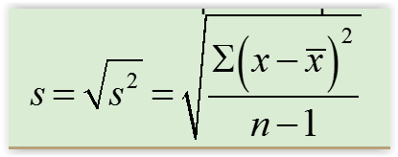
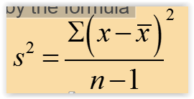
Analyze
Dispersion or Spread of Data
What we have is a discrete data with only two possible outcomes recorded as either success or failure with time span of month.
=max( ) – min( )
=stdev.s
=var.s
591 Failed vs 3532 Statements
Prepared by: Sathish Kumar Rajendiran

Slide 11
Analyze Time Series Plot
Time Series trend confirms unpredictable flow in the process confirming – the process is out of control. Trend is clearly heading in one direction where the number of failures keep raising with one big spike.
Its is a discrete data with only two possible outcomes recorded as either success or failure with time span of month. This graph is plotted on number of failures recorded over 12 months as sample size.
In addition, Regression calculation for Y is represented as 3.5979x +25.864
with R Square is calculated as 0.1284
Prepared by: Sathish Kumar Rajendiran

Slide 12
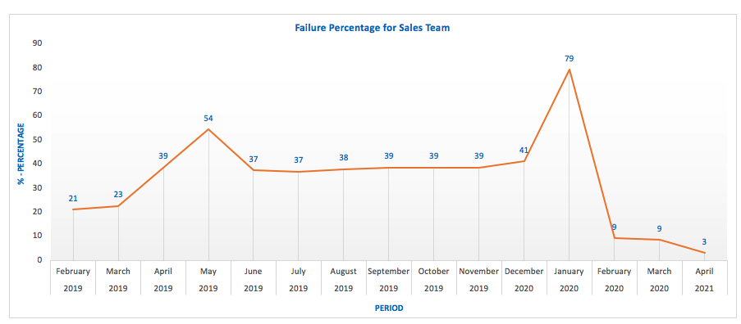
Analyze/Improve – Incorrect Payments - Time Series Trend
Prepared by: Sathish Kumar Rajendiran

Slide 13
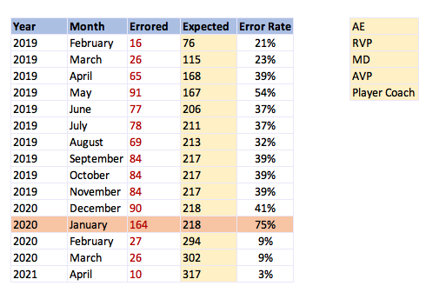
Analyze/Improve – Overall Failures/Incorrect Payments
Prepared by: Sathish Kumar Rajendiran

Slide 14
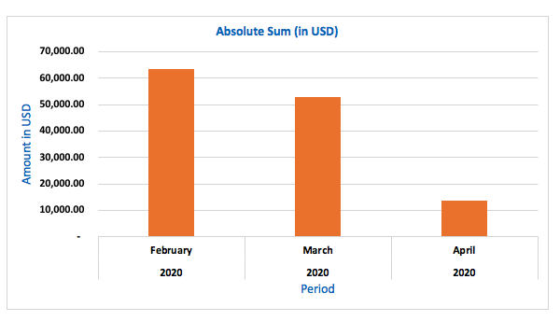
Analyze – Absolute amount in USD (Incorrect payments)
Prepared by: Sathish Kumar Rajendiran

Slide 15
Improve – Process Map (Proposed Solution)
Mandatory Validation –before uploading monthly Sales data
If any errors were found, then root cause analysis is mandatory
Prepared by: Sathish Kumar Rajendiran

Slide 16
Control
Next Steps (Conclusion)
Since, We’re dealing with monthly process, it is difficult to jump into conclusion on whether by simply minimizing data stratification factors (x variables) alone would solve the problem. However, Based on the samples we analyzed from historical months and validating it against last month had shown significant proof that process would result in 100% accuracy. In addition, We have also recommended making it mandatory to capture these factors whenever a commission statement is re-issued. I consider this as a SUCCESS of this Project.
So, the following recommendations were also provided to both SalesOps and Accounting team respective owner and Stakeholders of this process to,
Train AEs from Sales and Analysts from Accounting team to prepare the metrics in advance and setup checks & balances on each stage of the process
Document Validation checks
Include Controls to get timely bookings import
Add more transparency on what AEs to get paid vs. actually paid on, so that AEs can raise concerns before commission payments are uploaded to ADP
In addition, Continuously monitor for next several months to further improve the process as the impacts are in 10s of thousands of dollars!
Prepared by: Sathish Kumar Rajendiran

